Slide 2






Meet the Team
Arya Anandkumar
Aparna Bejoy
Ayela Chughtai
Ben Chu
Dhaval Patel
Sreejony Sengupta

Slide 3




Presentation Agenda
Problem Overview: integrating successes from provided Sales & Analytics data to locate new areas in the United States
Methodology: creating a standardized evaluation system that we can use to compare cities in different locations
Executive Summary
Cities: creating a profile of metrics for cities that we will be recommending within different areas
Next steps: laying out the importance of our findings and figuring out how Empowerly can use this information

Slide 4
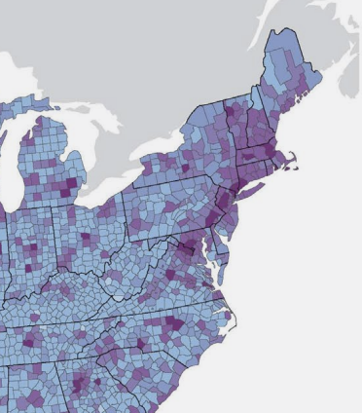


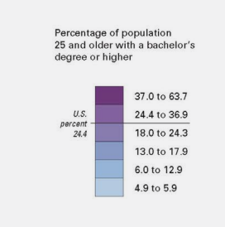

Methodology
The base of assumptions and steps we moved through for picking our cities
Analyzing education levels in all four regions and narrowed it down to the Northeast
The Northeast region is more densely packed and educated
Education Level
Used demographic and geographical data from Sales & Analytics to come up with specific metrics of success
Narrowed regions down to counties within the Northeast
Metrics
Located specific cities within each county that would be the most beneficial to expand into
Directly comparable to data points for San Mateo
Standardization
Conclusion
Our methodology consisted of three phases that narrowed the scope of possible cities in which Empowerly could expand successfully

Slide 5
Metrics
What we chose as metrics for success and why
Standard of Living
Households with a higher standard of living place a larger value on education
More wealth means higher willingness to spend
% of Asian + White Pop
Large proportion of Empowerly’s current clients fall within this demographic
Potential opportunity to diversify customer base in certain areas
Income +
Household Price
Ethnic
Demographic
$ Spent on Education
Differentiates between public and private schools
More investment into education results in higher willingness to spend on external services
Metrics
% of 15-19 year old
Primary customers are students that are currently in high school
Gain an understanding of the population’s general age composition
Investment
in
Education
Age
Demographic
% w/ College Education
Parents that have a college education would be more inclined to have their children go to college
Bay Area has a high college education rate
Education
Demographic
US News Ranked High
Schools
Top Ranked High Schools
Highly ranked high schools might not have the resources to have internal counseling but do have ambitious students actively seeking services

Slide 6
San Mateo, CA
San Mateo, California is an urban city in San Mateo County
Standard of Living
MI: $109,899
MHP: $1,350,000
% w/ College Education
20.88% - 16,008 people
% of 15-19 yr. olds
6.33% - 6,157 people
% of Asian + White Pop.
25% - 25,556 people
51.46% - 53,551people
$ spent on Education
$1,605
Top Ranked High Schools
3
Conclusion
Characteristics on San Mateo that we believe contributed to Empowerly’s success in the city are its high median household income and high median household spending on education.

Slide 7
Newton, MA
Newton, Massachusetts is a suburban city in Middlesex County
Standard of Living
MI: $118,000
MHP: $1,060,000
% w/ College Education
76% - 68,000 people
% of 15-19 yr. olds
6.0% - 5,300 people
% of Asian + White Pop.
13% -11,500 people
77% - 68,500 people
$ spent on Education
$2,850
Top Ranked High Schools
2
Conclusion
Newton is an ideal choice if you are looking to target an affluent, predominantly white population with a high percentage of college graduates.

Slide 8
Somerset, NJ
Somerset is the wealthiest county in New Jersey by per capita income
Standard of Living
MI: $112,000
MHP: $533,000
% w/ College Education
86% - 21,309 people
% of 15-19 yr. olds
16.8% - 4,162 people
% of Asian + White Pop.
18.6% - 4,608 people
37% - 9,168 people
$ spent on Education
$8,496
Top Ranked High Schools
2
Conclusion
Somerset is an ideal choice if you are looking to target an affluent and well-education population.

Slide 9
Cambridge, MA
Cambridge, Massachusetts is home to Harvard and MIT
Standard of Living
MI: $89,000
MHP: $670,000
% w/ College Education
75% - 85,000 people
% of 15-19 yr. olds
10.0% - 11,800 people
% of Asian + White Pop.
15% - 15,900 people
66% - 75,000 people
$1,640
Top Ranked High Schools
3
$ spent on Education
Conclusion
Cambridge is an ideal choice if you are looking to target a predominantly middle class city with a high percentage of residents between the ages of 15 and 19.

Slide 10
Greenwich, CT
Greenwich is ranked#4 on CNN’s list of 100 Best Places to live in the US
Standard of Living
MI: $94,309
MHP: $972,300
% w/ College Education
59% - 36,000 people
% of 15-19 yr. olds
14% - 8,542 people
% of Asian + White Pop.
12.7% - 7,874 people
74% - 45,800 people
$21,654
Top Ranked High Schools
1
$ spent on Education
Conclusion
Greenwich is an ideal choice if you are looking to target a population who have historically spent more on education.

Slide 11
Jersey City, NJ
Jersey City is the second most populous city in New Jersey
Standard of Living
MI: $62,000
MHP: $487,000
% w/ College Education
26% - 50,000 people
% of 15-19 yr. olds
6.25% - 12,000 people
% of Asian + White Pop.
25% - 67,000 people
35% - 94,000 people
$ spent on education
$740
Top Ranked High Schools
2
Conclusion
Jersey City is an ideal choice if you are looking to target a city with a high percentage of Asian households and a population that is not already well versed in the college admissions process.

Slide 12
Irvine, CA
Irvine, California is a city in Southern California that has UC Irvine in it
Standard of Living
MI: $96,938
MHP: $726,200
% w/ College Education
20.93% - 450,915 people
% of 15-19 yr. olds
7.66% - 259,159 people
% of Asian + White Pop.
20.52% - 654,727 people
58.04% - 1,851,955 people
$1,697.88
Top Ranked High Schools
5
$ spent on Education
Conclusion
We believe Irvine would be an ideal place to expand to based on a high standard of living, a large median household spending on education, and many children within the desired demographic

Slide 13


Competitive Analysis
Competitive analysis within the Northeast markets
Newton, MA
Cambridge, MA
Jersey City, NJ
Greenwich, CT
Somerset, NJ
26
13
13
24
33
Above average Yelp reviews (Typically 3/5 stars or greater)
About 40% of the services offered are concentrated within a 5 mile radius
Many of the businesses with the most reviews were poorly rated
About 50% are private independent tutors
About 33% of the companies present have in person services
Conclusion
The demand for college counseling services exists at each of these locations because there are multiple companies offering services as of now.
Empowerly can capitalize on new customers through their more affordable, easier to access, and more standardized services

Slide 14
Next Steps
Outline the content of the next deliverable and discuss the aspects to synthesize
Discuss
Synthesize
Outline
Understand the different recommendations and the methodology behind them
Discussing how this research comes into play for the current plans that Empowerly has
Reflect on the different cities and whether the marketing strategy will include them
Synthesize any additional information or data points that could be necessary for the next deliverable
Come up with an outline on the types of information the marketing strategy should contain
Gain an understanding of the current marketing strategy Empowerly is employing for better integration

Slide 16
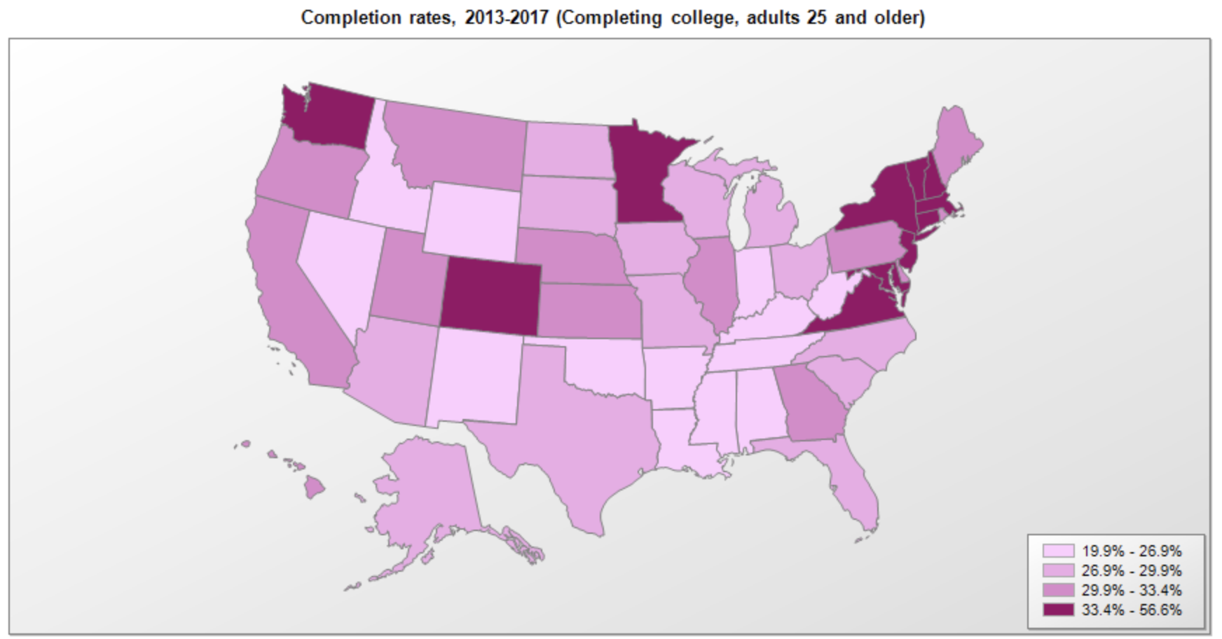
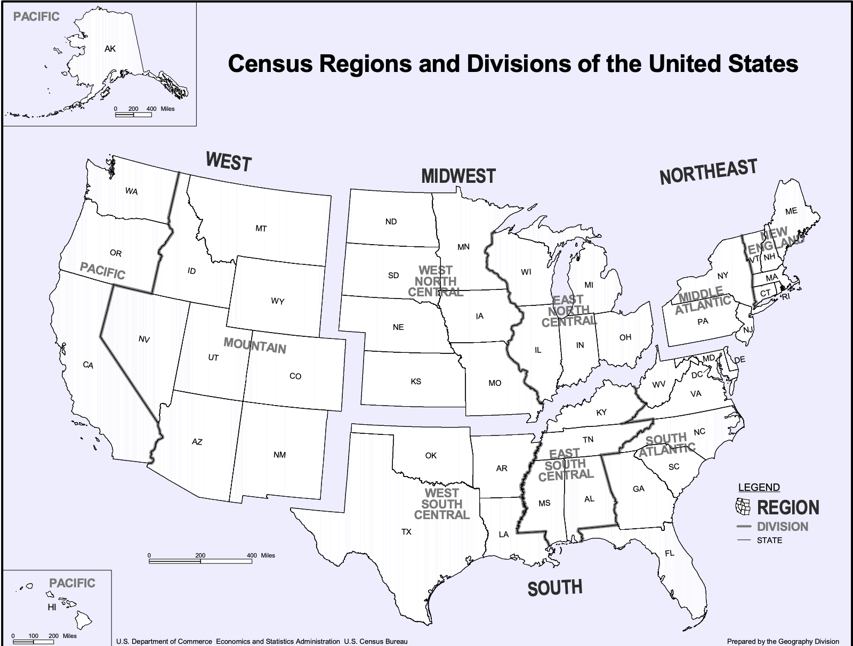
Education Levels – Reference
How we decided to target the Northeast
State | Count of State
AL | 2
CA | 9
CO | 8
CT | 3
DC | 1
FL | 3
GA | 7
IA | 3
IL | 4
IN | 3
KS | 3
KY | 2
MA | 5
MD | 4
ME | 1
MI | 2
MN | 6
MO | 3
MS | 1
MT | 1
NC | 5
NE | 1
NH | 1
NJ | 8
NM | 1
NY | 7
OH | 2
OR | 3
PA | 5
PR | 1
RI | 3
SC | 2
SD | 1
TN | 2
TX | 8
UT | 2
VA | 16
VT | 1
WA | 1
WI | 3
WV | 1
Grand Total | 145
Access to spreadsheet with filtered data that helped narrow down the region:
https://drive.google.com/file/d/1zskm82UvsmAJzbuHHu5ZY6kUq9grxcxy/view?usp=sharing
Count of Regions
Regions | Total
Midwest | 31
N/A | 1
Northeast | 34
South | 52
West | 27
Grand Total | 145
Access to spreadsheet with filtered data that helped narrow down counties:
https://drive.google.com/file/d/1ZH4wY6B1BA7PUOFM6vL22z3n2wgMQiA9/view?usp=sharing
https://www.ers.usda.gov/data-products/county-level-data-sets/download-data/
https://seer.cancer.gov/seerstat/variables/countyattribs/ruralurban.html

